Slide 1


Pune Vidyarthi griha’s college of engineering and shrikrishna s. dhamankar institute of management, nashik - 422004
Presentation on
SMART CONTRACT ENABLED ONLINE EXAMINATION SYSTEM BASED ON BLOCKCHAIN NETWORK
SAVITRIBAI PHULE PUNE UNIVERSITY
Group 13
Guide: Prof. A. S. Pingle
Group Members:
Jadhav Vivek Suresh (38)
Sabale Sainath Santosh (47)
Vaidya Bhaskar Narayan (48)
Pawar Anurag Suhas (52)

Slide 2
PRESENTATION OUTLINE
ER-Diagram
UML Diagram
Data Flow Diagram
SDLC Diagram
Test Cases
Advantages
Limitations
References
Conclusion
Problem Statement
Introduction
Motivation
Literature Review System Requirements
Functional Requirements
Non- Functional Requirements
Implementation Plan
System Architecture

Slide 3


Problem Definition
PROBLEM STATEMENT
In this system, we're attempting to create a cost-effective online exam system by integrating blockchain technology into an already-existing system, which will improve the security of administering such exams.

Slide 4
INTRODUCTION
Nowadays everything has been shifted on the Internet and anyone can access the information from anywhere. It raises the new challenges such as data security, transparency, and trust over the global network. Many universities and independent organizations such as National Testing Agency (NTA) are conducting the examination online and it may be used world widely in near due to COVID-19. Trust and security are the major constraints for such online examination systems. Several global market players are offering private network lockers, password, One-Time Password (OTP) and strong security passwords etc. The information security is one of the key challenges in existing solutions due to involvement of third party. Blockchain is an emerging technology that starts the revolution of privatization and data is always on the user’s hand. There is no third-party involvement in blockchain network for accessing and processing the services.

Slide 5
Motivation
MOTIVATION
The cloud-based system are widely adopted by many educational organizations. Many government examinations are conducted on this platform. But there are lots of challenges that are generated.
One of the biggest challenges is the security of data .We Know there are lots of hackers present on the network, steals the data, for which we use the firewalls for security Reasons, but this is not enough.
Due to the many Firewalls and anti-virus systems increase costs. And expenditure.
And the third issue is user authentication, i.e., The only valid candidate in the examination system is present.

Slide 6
LITERATURE SURVEY
Sr. No. | Title | Author/ Year Published | Method Algorithm used | Features | Discription
1. 2. | Smart Contract enabled Online Examination System Based in Blockchain Network Blockchain Technology: A Step Towards Sustainable Development | Mr.Apoorv Jain1 & Dr. Arun Kumar Tripathi2 2021 P.Chinnasamy, P.Deepalakshmi, V. Praveena, K.Rajakumari, P.Hamsagayathri, (2019) | PoW or PoS consensus algorithm for validating every data block node Blockchain, Bitcoin, Sustainable Supply chain, Smart Contract, Peer-Peer Networking, Consensus. I. INTRODUC | blockchain offers secure, decentralized data management with user control, using cryptographic validation and Smart Contracts for data integrity, eliminating third-party security challenges Consensus is crucial for agreement in decentralized systems like message passing. Consider a scenario where generals with Byzantine army forces surround a city; some favor attack while others prefer retreat. Consensus is needed to avoid a failed attack. Similarly, blockchains face this challenge as they lack central servers or nodes in their distributed networks. | This paper emphasizes blockchain's role in education, introduces an Ethereum-based online exam system with Smart Contracts, highlighting its advantages over traditional cloud systems. It also explores how Smart Contracts improve resource management and decision-making in education, promoting their adoption in modern education. In 2018, Gartner's Hype Cycle highlighted blockchain's potential in digital identity, food supply chains (e.g., IBM Food Trust), voting, payments, and security tokens (e.g., real estate tokenization).

Slide 7
LITERATURE SURVEY
Sr. No. | Title | Author/ Year Published | Method Algorithm Used | Features | Discription
3. | Blockchain-Based Smart Contract Towards Developing Secured University Examination System | Naresh Chandr & P.Chinnasamy 2020 | PoW or PoS consensus algorithm for validating every data block node | This paper presents a secure Question-Set Preparation (QS) scheme leveraging blockchain security. It employs a two-phase encryption process to prevent unauthorized access before exams, enforces time restrictions, and necessitates user permission for decryption. The master uses a proposed algorithm to randomize QSP selection, collectively bolstering the security of the QS system. | The COVID-19 pandemic has amplified the challenges of service delivery worldwide. Many educational institutions have been closed or have limited access since March 2020, leading to widespread adoption of remote work and online learning. This situation underscores the need for effective and secure solutions to disseminate knowledge in a large, distributed environment.

Slide 8
Functional Requirements
FUNCTIONAL REQUIREMENTS
System Feature 1
Easy to adapt with the system architecture and user interface.
System Feature 2
An system Blockchain is used as a tamper proof storage for unchanged,
accurate results

Slide 9
NON-FUNCTIONAL REQUIREMENTS
Performance Requirements
Safety Requirements
Security Requirements
Software Quality Attributes

Slide 10
SYSTEM REQUIREMENTS
Database Requirements
MongoDB (NoSQL)
Software Requirements
PHP
MongoDB (NoSQL)
Blockchain
Ethereum
Remix-IDE
Solidity
MetaMask
Ganache
Hardware Requirements
RAM – 8GB or higher
Minimum 128 GB SSD/ 256 GB HDD
Intel i3 8th Generation or Equivalent
64 bit System

Slide 11
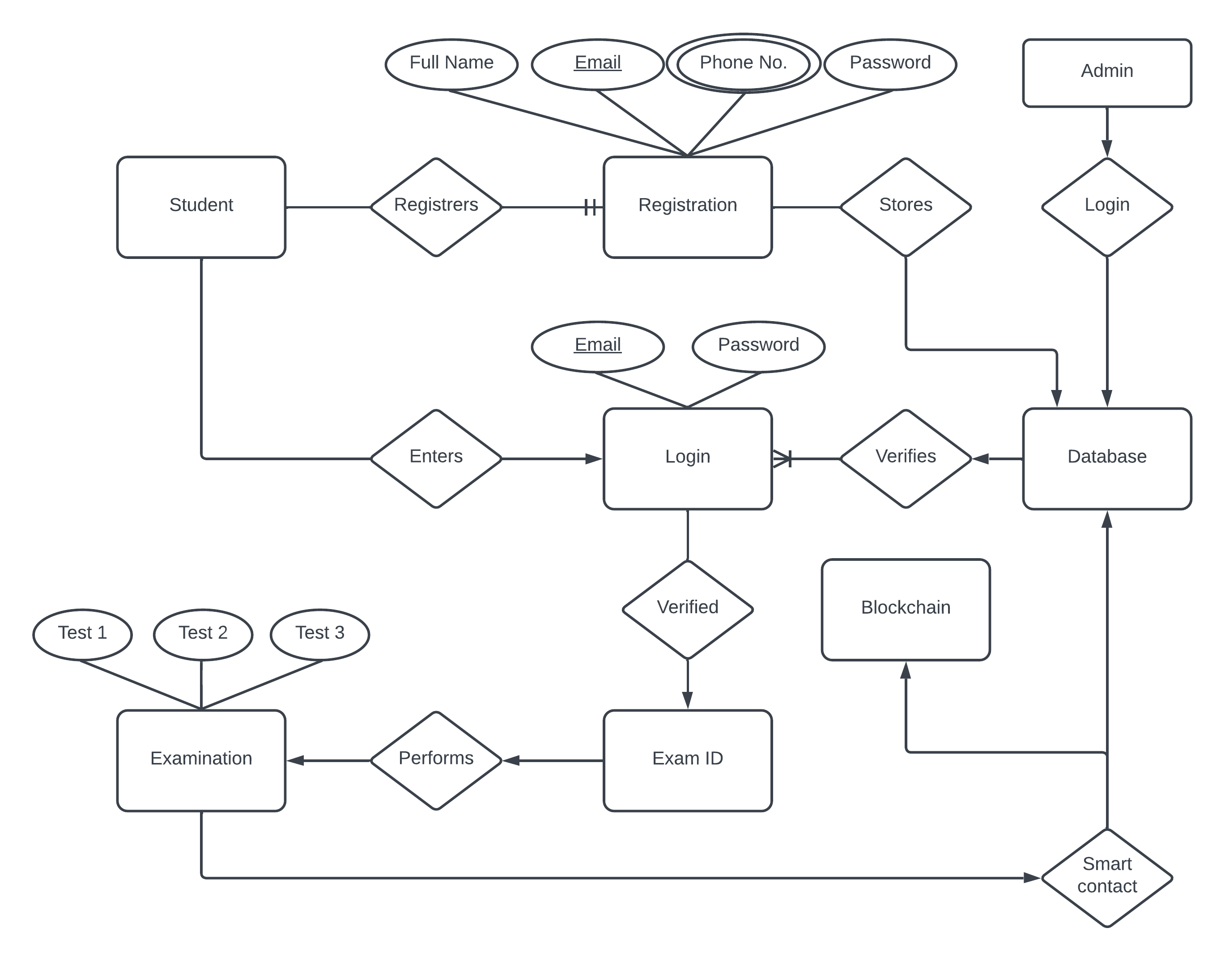
Entity Relationship Diagram
ENTITY RELATIONSHIP DIAGRAM
Figure 04 : Entity Relationship Diagram

Slide 12
System Implementation Plan
SYSTEM IMPLEMENTATION PLAN
Planning is the very important step involved in system implementation.
The first and most crucial stage in implementing a system is planning. It is the most fundamental role and successfully answers the problems of how, where, and when the objectives can be achieved, or it acts as a framework for direction. Planning entails carefully evaluating both the resources that are already available and any obstacles that the team may face in achieving its business objectives or goals

Slide 13
4. System Design
SYSTEM DESIGN
System Architecture
Data Flow Diagrams
Entity Relationship Diagram
UML Diagram

Slide 14
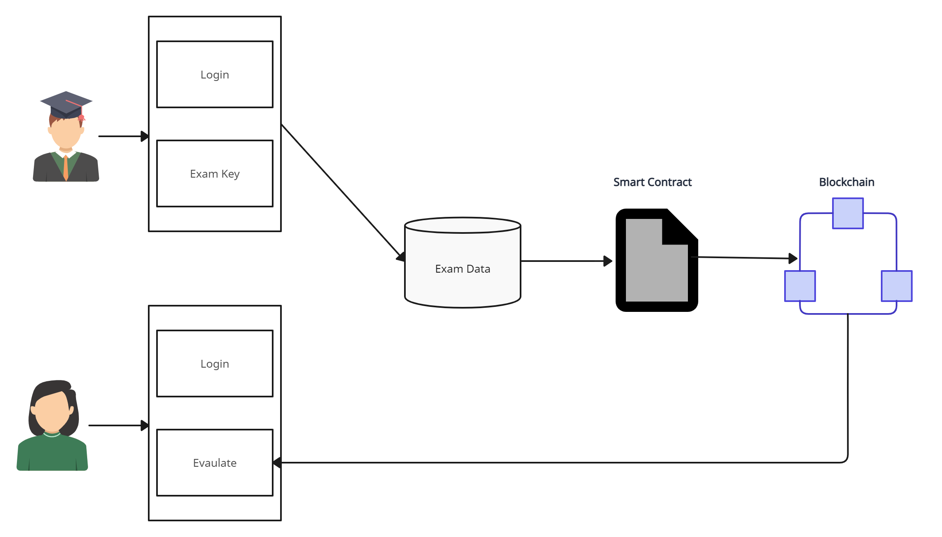
System Architechture
SYSTEM ARCHITECTURE

Slide 15
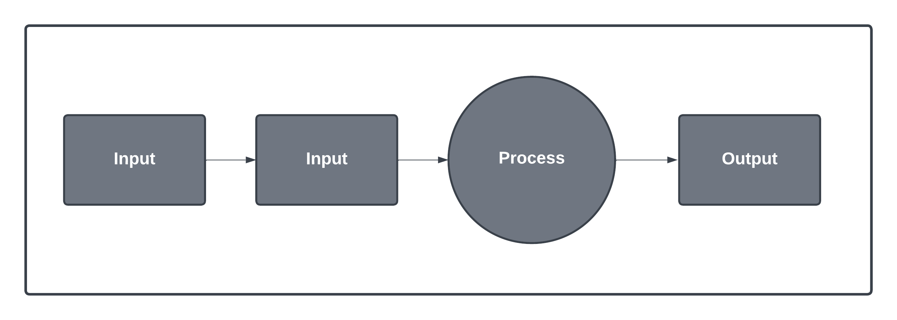
Data Flow Diagram
DATA FLOW DIAGRAM
Figure 03 : Data Flow Diagram – lvl 0

Slide 16
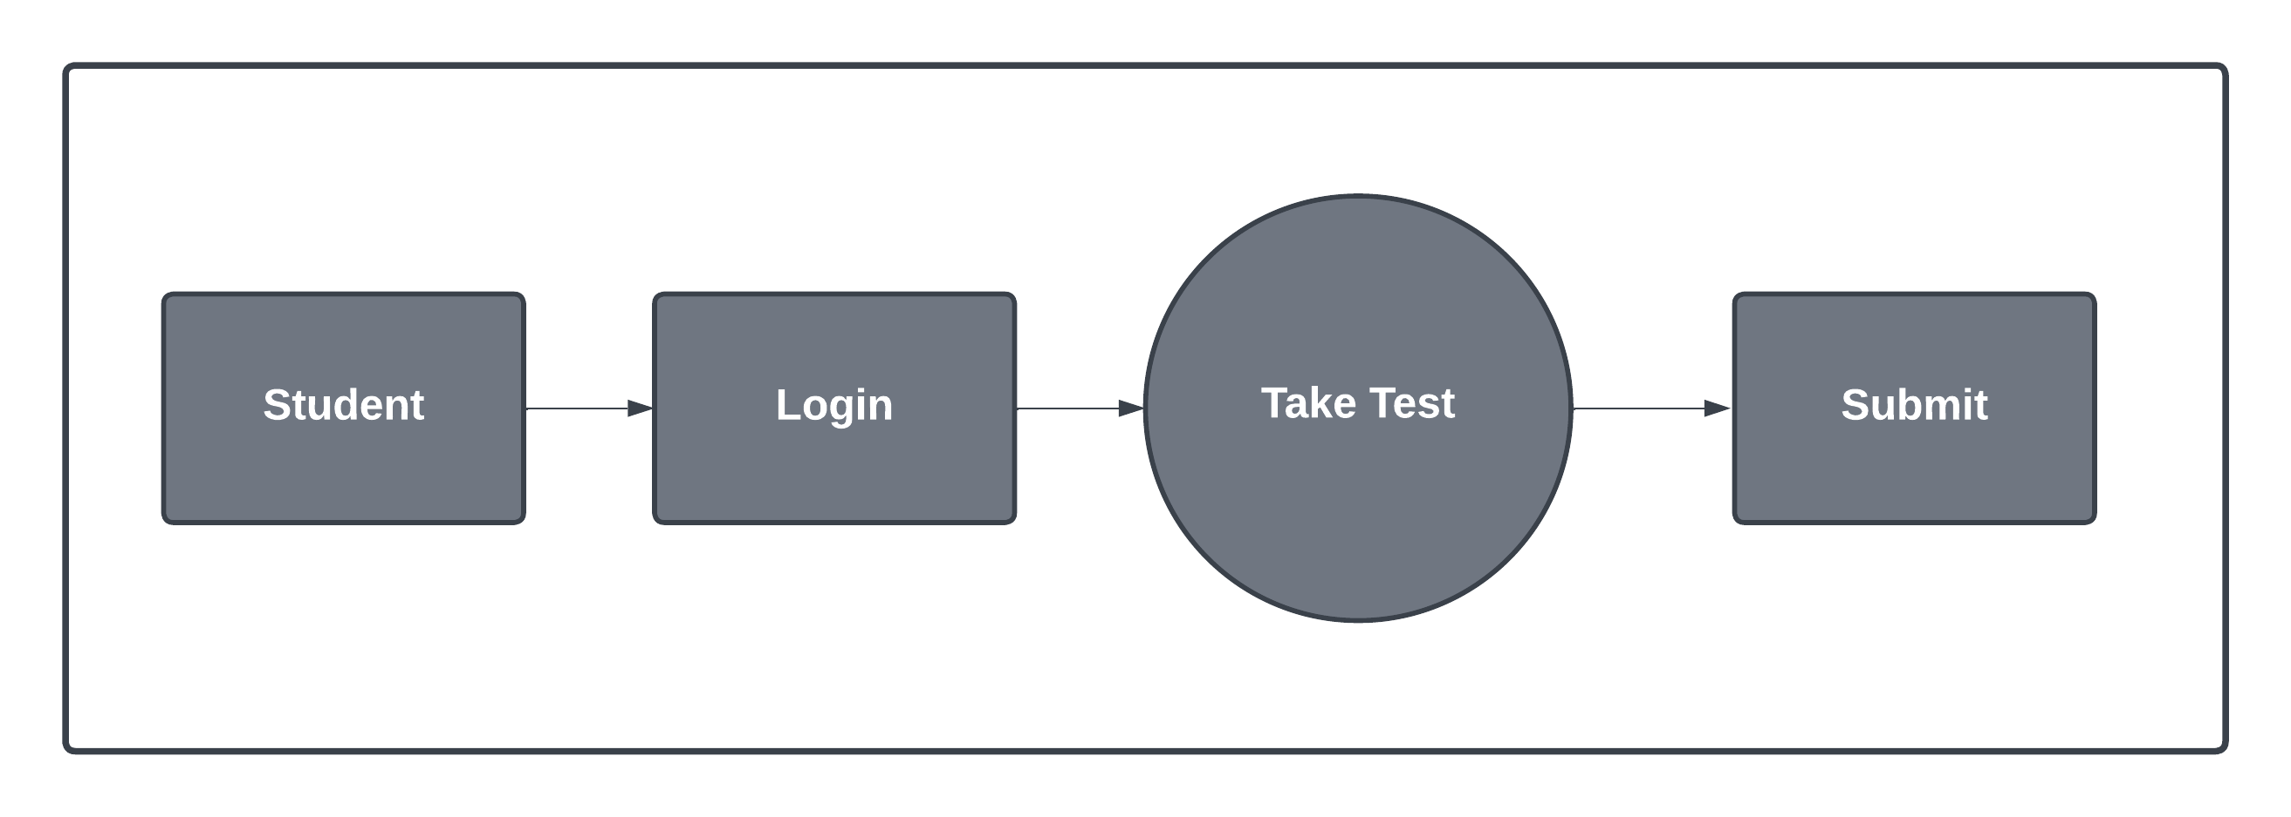
Data Flow Diagram
DATA FLOW DIAGRAM
Figure 03 : Data Flow Diagram – lvl 1

Slide 17
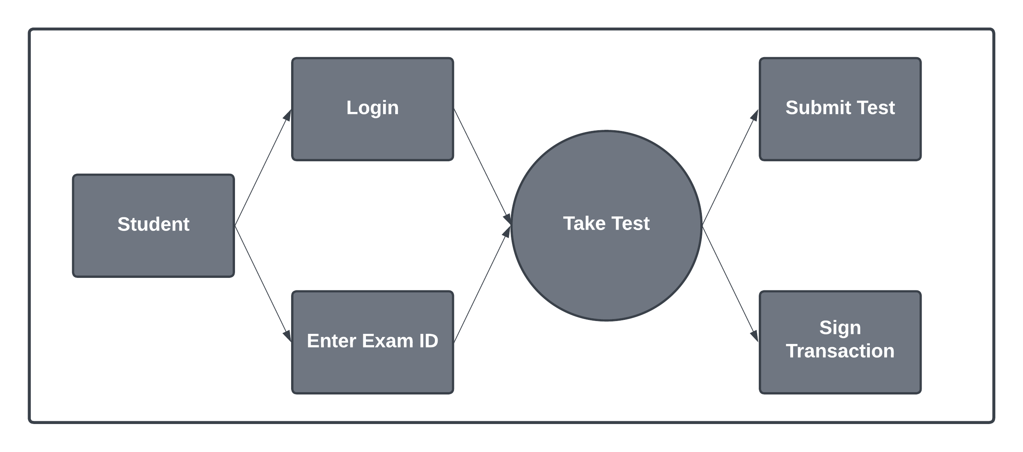
Data Flow Diagram
DATA FLOW DIAGRAM
Figure 03 : Data Flow Diagram – lvl 2

Slide 18
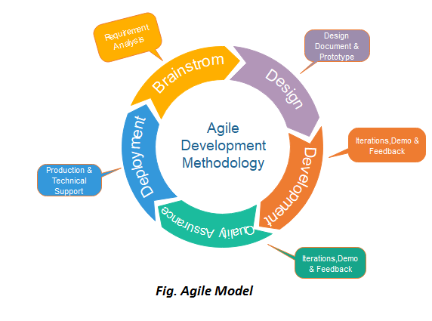
Analysis Model: SDLC to be Applied
SDLC DIAGRAM
Source : Internet

Slide 19
5. Project plan
PROJECT PLAN
Research and Familiarization
System architecture Design
Smart contract development
Blockchain Integration
Front- End development
Back-End development

Slide 20
Test cases
TEST CASES
Sr. No. | Test case ID | Test case name | Actions | Required data | Expected output | Actual output | Status | Comments
1 | TC_001 | Student Take Exam | 1.Enter student login details. 2. Enter the Exam key. 3.Submit the exam | Login details and Exam key | Upon submitting the test the MetaMask wallet should popup to submit the exam through smart contract | After submit ting the test the Meta Mask wallet popped up to submit the exam through smart contract | PASS | NIL

Slide 21
Test cases
TEST CASES
Sr. No. | Test case ID | Test case name | Actions | Required data | Expected output | Actual output | Status | Comments
2. | TC_002 | Faculty create exam | 1.Enter teacher login details 2. Create exam with schedule d time and publish it. | Faculty login details | Exam created successfull y | Exam created successfull y | PASS | NIL

Slide 22
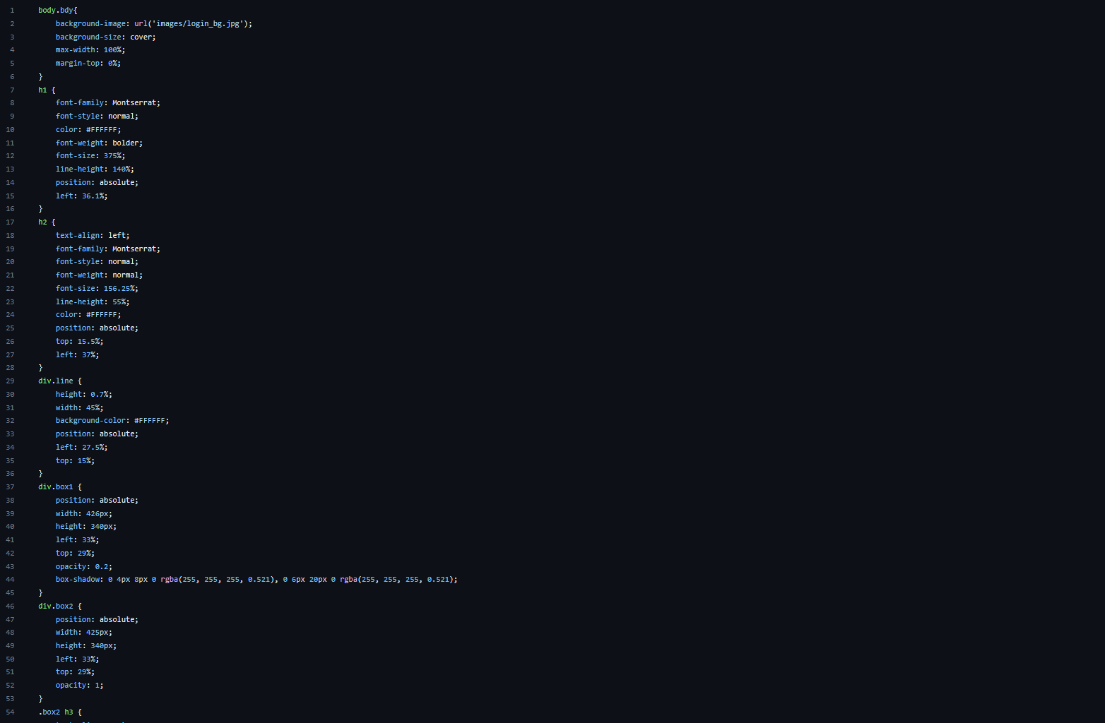
CODING
.css

Slide 23


Slide 24
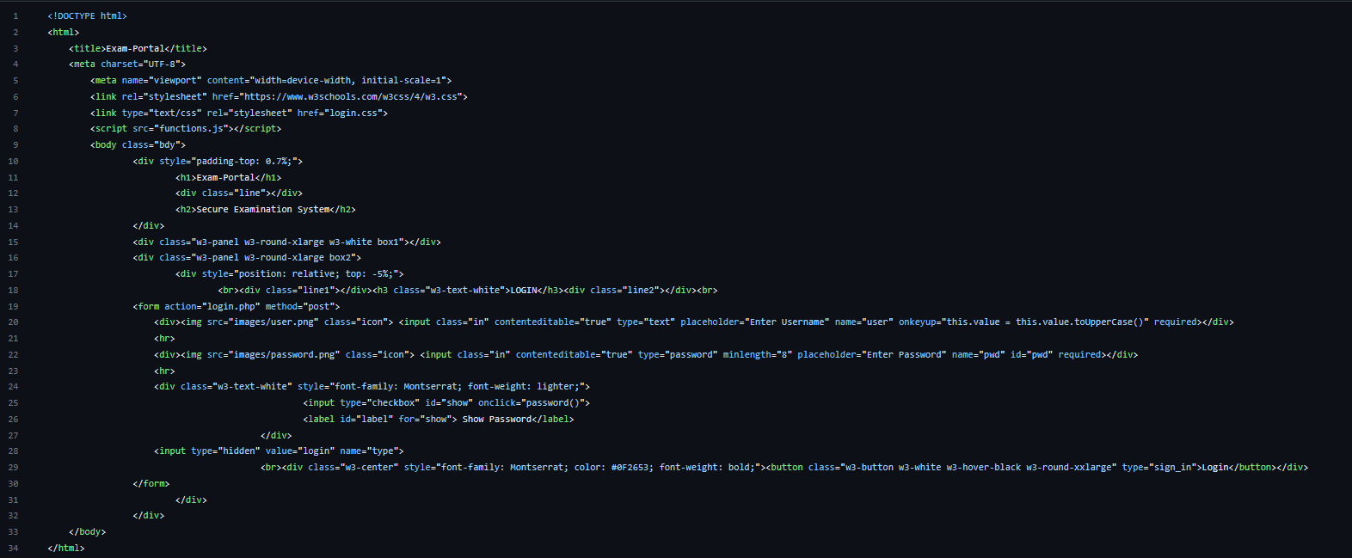
.html

Slide 25
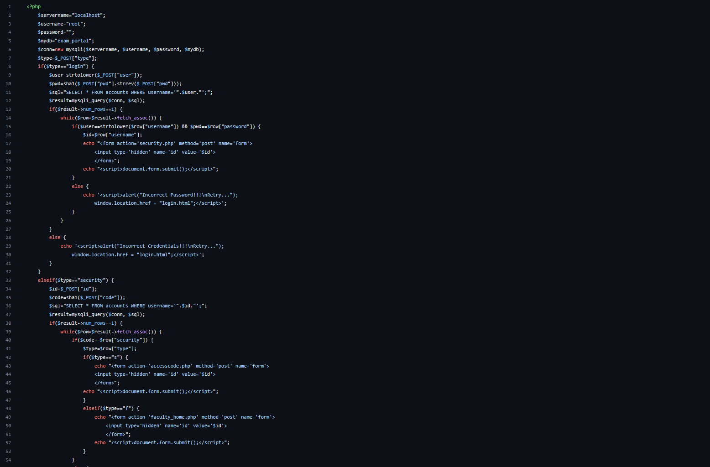
.php

Slide 26
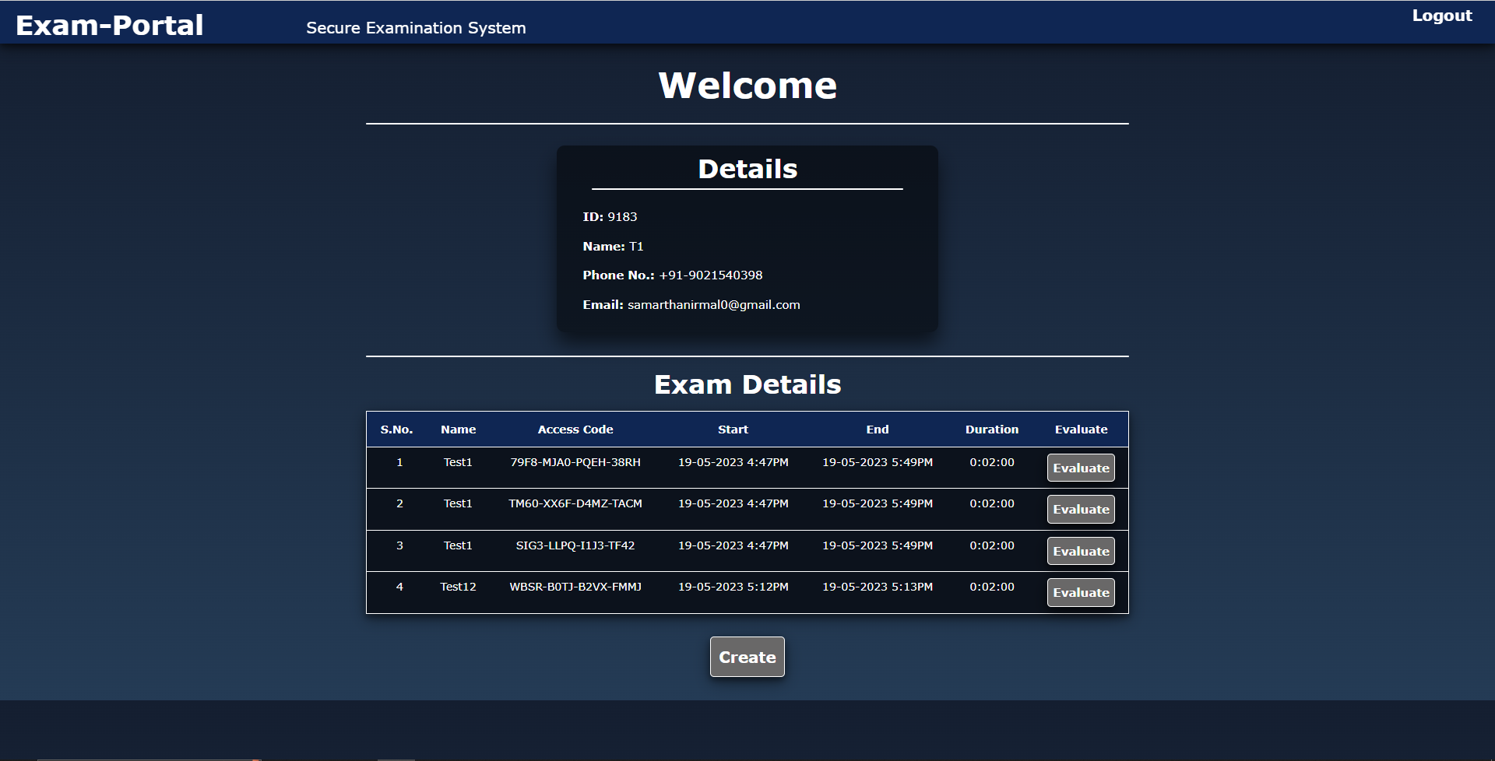
8.
Results
anurag.pawar@gmail.com

Slide 27
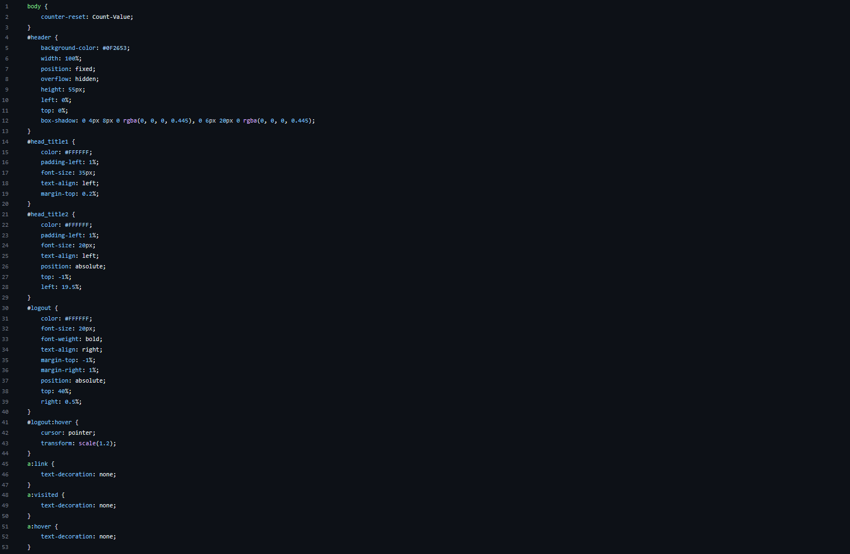
Results

Slide 28
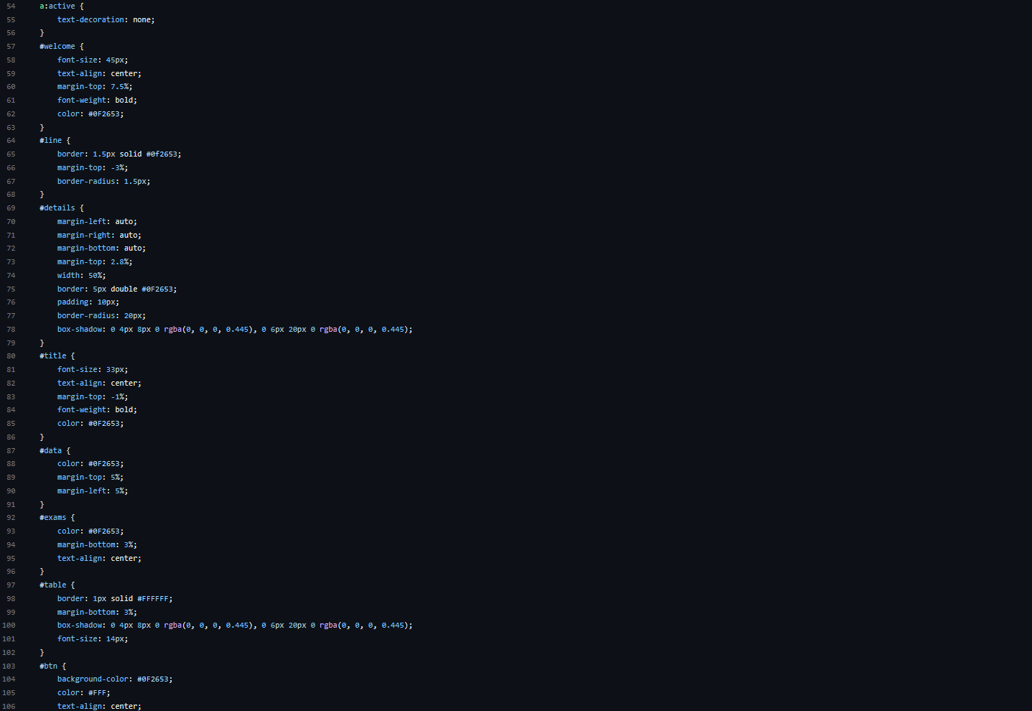

Slide 29
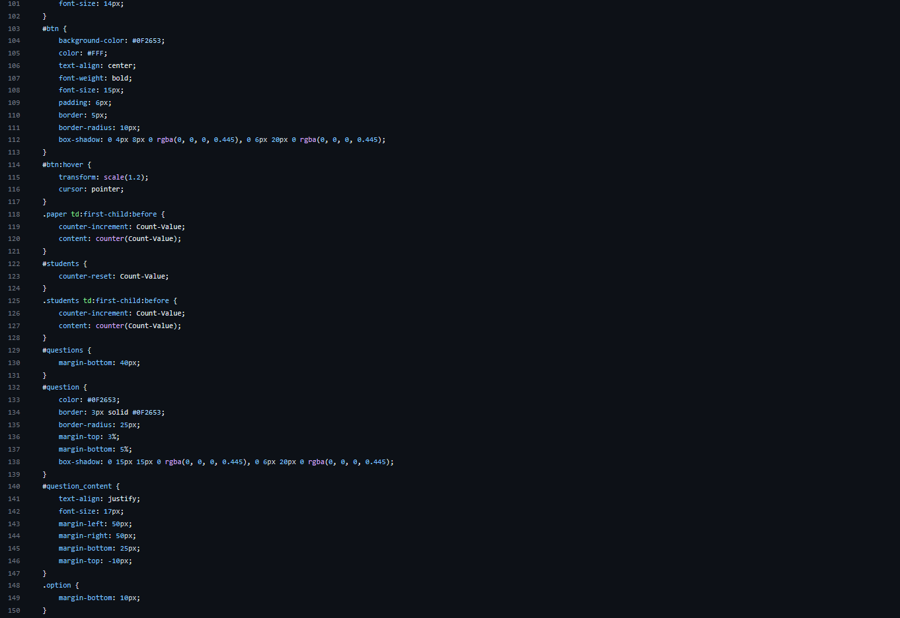

Slide 30
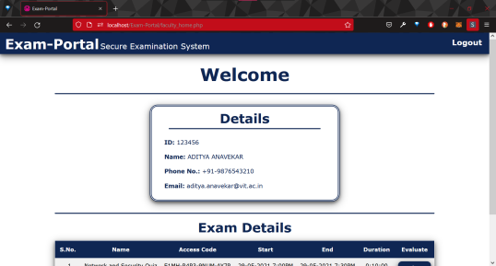
RESULTS
Results

Slide 31
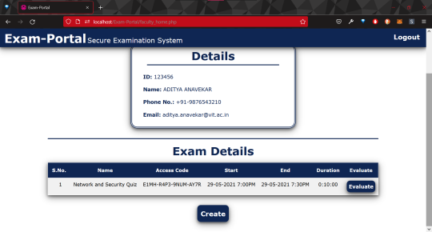
RESULTS
Results

Slide 32
ADVANTAGES
The biggest advantage of blockchain is its decentralised ledger application, which is proof of work, in which all the things are present in ledger form, which is generated automatically without the need of any third parties.
In the blockchain-based system, there is no need for external equipment requirements like data centres, Data warehouses or firewall extensions like cloud-based systems.
Blockchain technology overcomes and solves all these cloud-based system issues.
Blockchain is a highly secured, transparent, and authenticated blockchain network. Blockchain is a highly secured, transparent, and authenticated blockchain network.
There will never be any data exchange, transaction failures; if it's failed, then it stops and destroys all data at failure time.

Slide 33
LIMITATIONS
This system requires permission from the student's camera, microphone, and gyro to record students' activities from the device they use to attend the exam.
This system requires a stable internet connection
The internet outage can become the reason for an imbalance in the learning management system of individual students while attending the exam.

Slide 34
References
REFERENCES
[1] S. Nakamoto, “Bitcoin: A Peer-to-Peer Electronic Cash System | Satoshi Nakamoto Institute,” 2008.
[2] M. Walport, “Distributed ledger technology: Beyond block chain,” Gov. Off. Sci., pp. 1– 88, 2015.
[3] P. Devine, “Blockchain learning: can crypto-currency methods be appropriated to enhance online learning?” ALT Online Winter Conf., 2015.
[4] W. Gao, W. G. Hatcher, and W. Yu, “A survey of blockchain: Techniques, applications, and challenges,” in Proceedings - International Conference on Computer Communications and
[5] P.Chinnasamy, P.Deepalakshmi, V. Praveena, K.Rajakumari, P.Hamsagayathri, (2019) “Blockchain Technology: A Step Towards Sustainable Development” International Journal of Innovative Technology and Exploring Engineering (IJITEE), Volume-9 Issue-2S2

Slide 35
References
[6] R. Beck, J. Stenum Czepluch, N. Lollike, and S. Malone, “Blockchain - The gateway to trust-free cryptographic
transactions,” in 24th European Conference on Information Systems, ECIS 2016,
[7] A. Kosba, A. Miller, E. Shi, Z. Wen, and C. Papamanthou, “Hawk: The Blockchain Model of Cryptography and
Privacy-Preserving Smart Contracts,” in Proceedings - 2016 IEEE Symposium on Security and Privacy, SP 2016, [8] “Node.js.” https://nodejs.org/en/ (accessed May 20, 2020). SIT, Department of Computer Engineering 2022-23 54
[9] “Index of /dist/npm/.” https://nodejs.org/dist/npm/ (accessed May 20, 2020).

Slide 36

Any Questions?

